Slide 1

Tecnológico de Costa Rica Escuela de Ingeniería Electrónica Improving Performance of Error-Tolerant Applications: A Case Study of Approximate Computing with an Off-the-Shelf Neural Accelerator Thesis for Masters Degree in Embedded Systems Tomás González Aragón
Notes:
Acelerador neuronal listo para usar.

Slide 2
Introduction

Slide 3
Approximate Computing
Computing Paradigm
Tradeoff: Accuracy vs Performance & Energy Efficiency
Error-Tolerant Applications
Notes:
Performance = rendimiento

Slide 4
Approximate Computing
Use of neural networks to accelerate error-tolerant applications.
Use of approximate computing to accelerate machine learning application.

Slide 5
Focus of this Work
Are OpenVINO and Myriad X suitable to accelerate error-tolerant applications?
Can approximate computing techniques be utilized to improve the performance of machine learning applications deployed using OpenVINO and the Myriad X VPU?

Slide 6
Objectives
Main Objective:
Explore off-the-shelf accelerators to implement algorithmic transformations for approximate computing, and approximate computing techniques to improve machine learning applications.

Slide 7
Objectives
Specific Objectives:
Experiment with OpenVINO in a PC and a Rapspberry Pi to understand if it is a viable alternative to apply the algorithmic transformation approximate computing technique on error-tolerant applications.
Measure the performance of the OpenVINO toolkit and Intel's Neural Stick 2 on a subset of five error-tolerant applications of the AxBench test-suite.
Select and benchmark three machine learning applications with the OpenVINO toolkit and Intel's Neural Stick 2 to set a baseline of execution time and power consumption.
Explore approximate computing techniques to improve the performance and energy efficiency of the selected machine learning applications.

Slide 8
Previous Work & Background

Slide 9
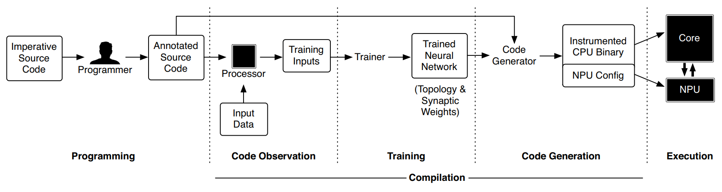
Parrot Transformation
Hadi Esmaeilzadeh, Adrian Sampson, Luis Ceze, and Doug Burger. Neural acceleration for general-purpose approximate programs. Proceedings - 2012 IEEE/ACM 45th International Symposium on Microarchitecture, MICRO 2012, pages 449-460, 2012.

Slide 10
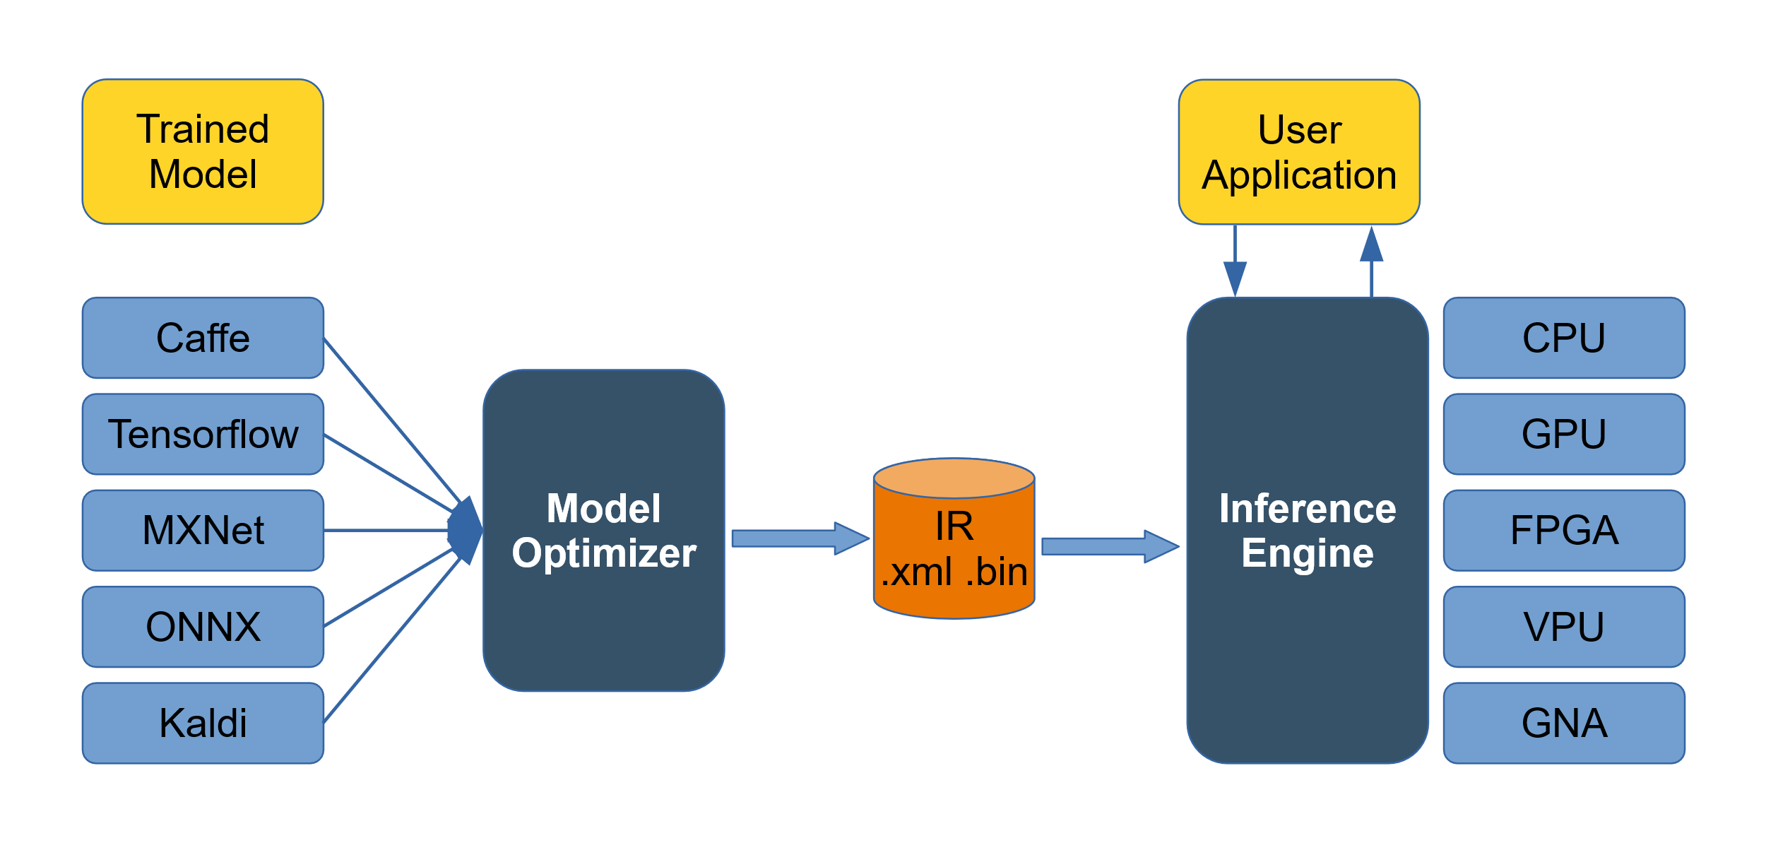
OpenVINO
https://software.intel.com/en-us/openvino-toolkit
Notes:
GNA =

Slide 11
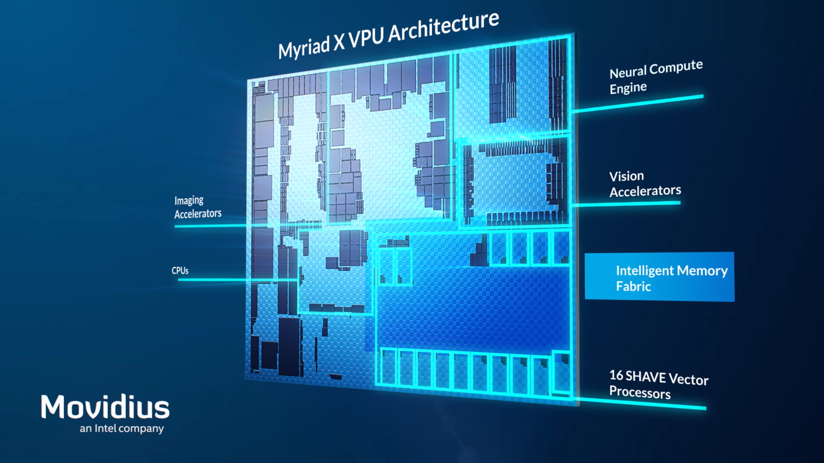
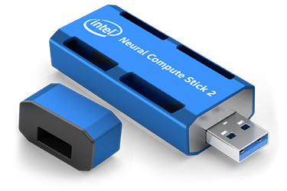
Myriad X & NCS2
https://www.anandtech.com/show/11771/intel-announces-movidius-myriad-x-vpu
https://ark.intel.com/content/www/us/en/ark/products/140109/intel-neural-compute-stick-2.html

Slide 12
The Work

Slide 13

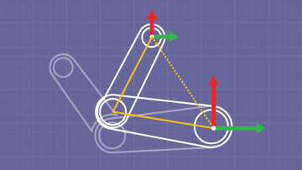
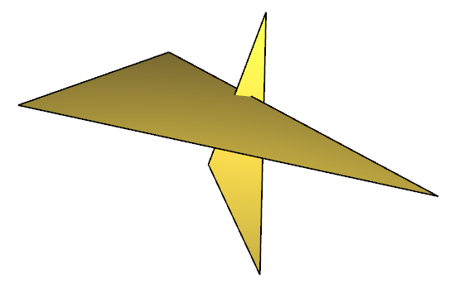
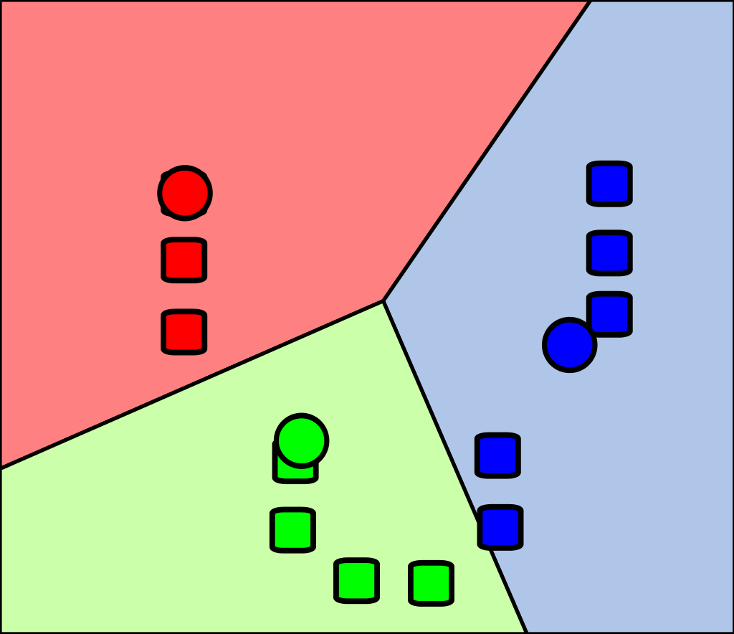
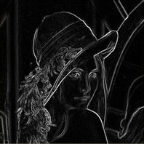
Test-Suite
Subset of AxBench applications.
Black-Sholes
Inversek2j
Jmeint
Kmeans
Sobel

Slide 14
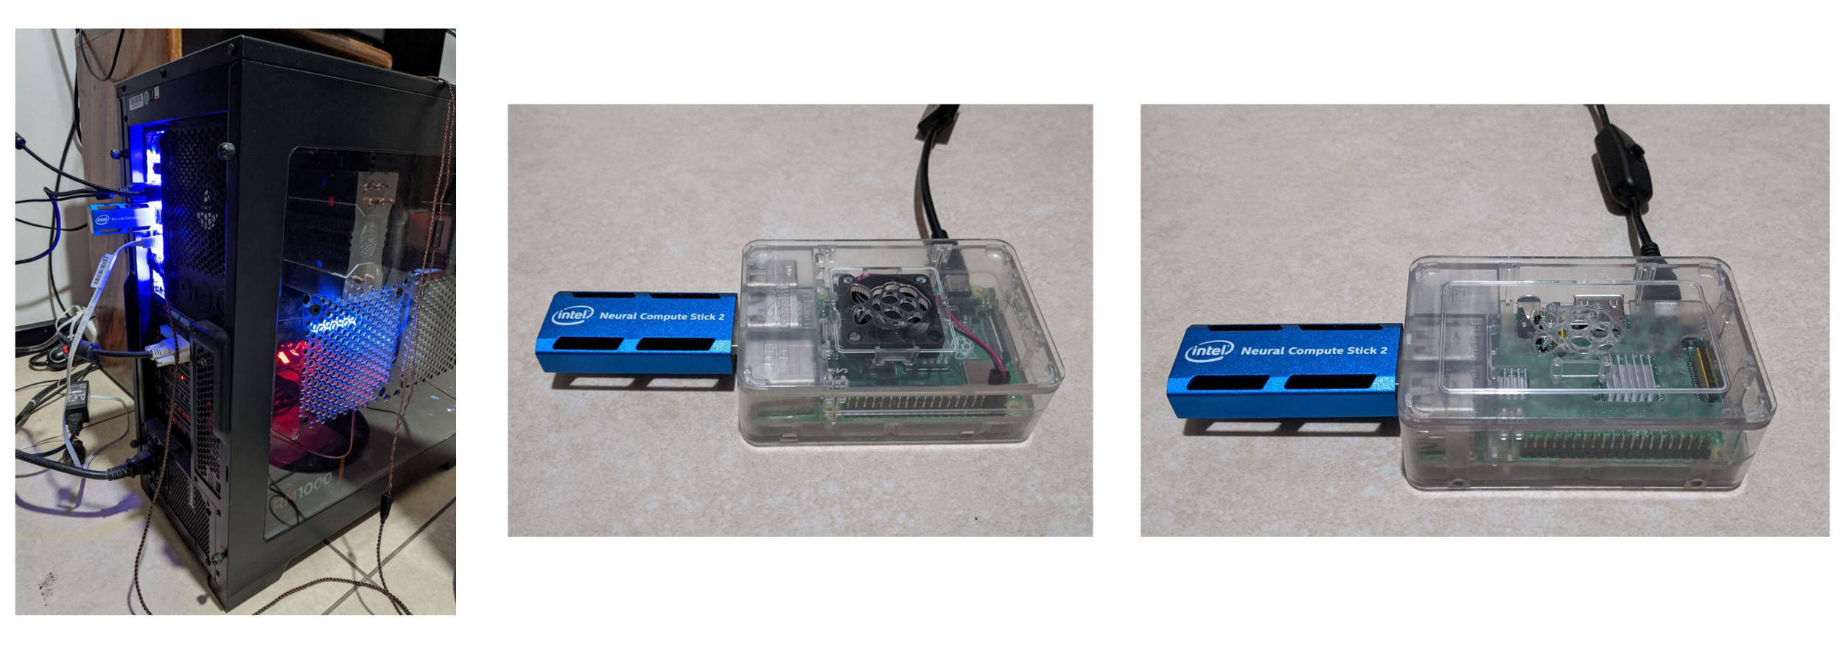
Tested Systems

Slide 15
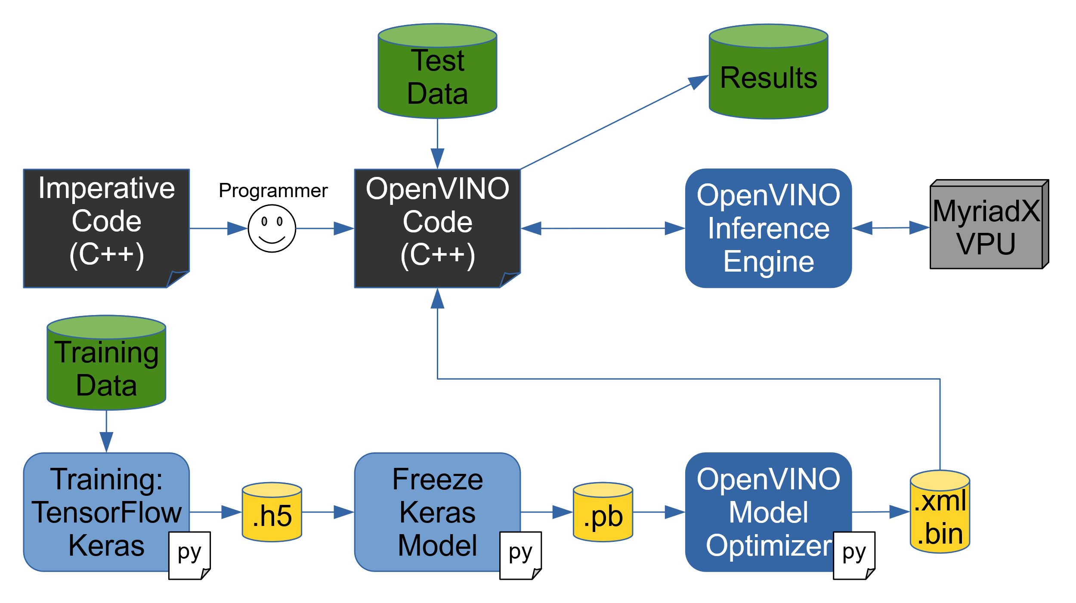
Workflow

Slide 16
Training
model = Sequential()
model.add(Dense(L1, activation='relu', input_shape=(I,)))
model.add(Dense(O, activation='relu'))
model = Sequential()
model.add(Conv2D(L1, (1,I), strides=(1,I), padding='valid',
activation='relu', input_shape=(B,B*I,1)))
model.add(Conv2D(O, (1,1), strides=(1,1),
padding='valid', activation='relu'))

Slide 17
Training
I = 3
L1 = 4
O = 2

Slide 18
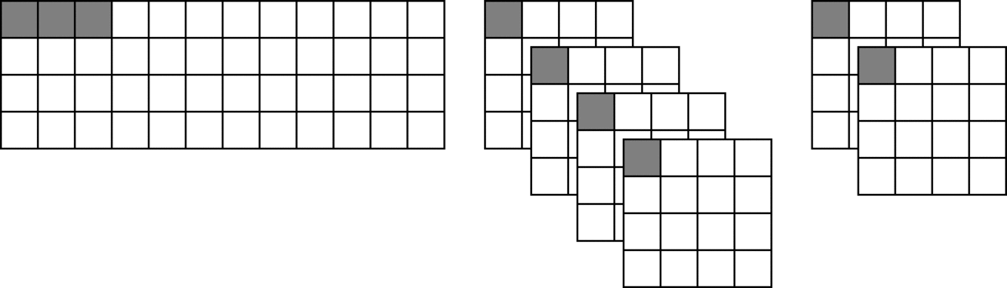
Training
I = 3
L1 = 4
O = 2
B = 4

Slide 19
Execution: Procedural Code
1 for (int i = 0; i < inputs.size(); i++) {
2 outputs[i] = ErrorTolerantFunction(inputs[i]);
3 }

Slide 20
Execution: Algorithmic Transformation – DNN
1 for (int i = 0; i < inputs.size(); i++) {
2 input_buffer[0] = inputs[i];
3 infer_request->Infer();
4 outputs[i] = output_buffer[0];
5 }

Slide 21
Execution: Algorithmic Transformation – CNN
1 for (int i = 0; i < inputs.size(); i += BLOCK_SIZE) {
2 for (int b = 0; b < BLOCK_SIZE; b++) {
3 input_buffer[b] = inputs[i + b];
4 }
5 infer_request->Infer();
6 for (int b = 0; b < BLOCK_SIZE; b++) {
7 outputs[i + b] = output_buffer[b];
8 }
9 }

Slide 22
Execution: Algorithmic Transformation – CNN Async
1 for (int i = 0; i < inputs.size(); i += BLOCK_SIZE) {
2 if (infer_request_is_active_and_ready(infer_request[ir])) {
3 for (int b = 0; b < BLOCK_SIZE; b++) {
4 outputs[iters[ir] + b] = output_buffer[ir][b];
5 }
6 }
7
8 for (int b = 0; b < BLOCK_SIZE; b++) {
9 input_buffer[ir][b] = inputs[i + b];
10 }
11
12 infer_request[ir]->StartAsync();
13 iters[ir] = i;
14
15 ir++;
16 if (ir == max_ir) ir = 0;
17 }

Slide 23
Results

Slide 24
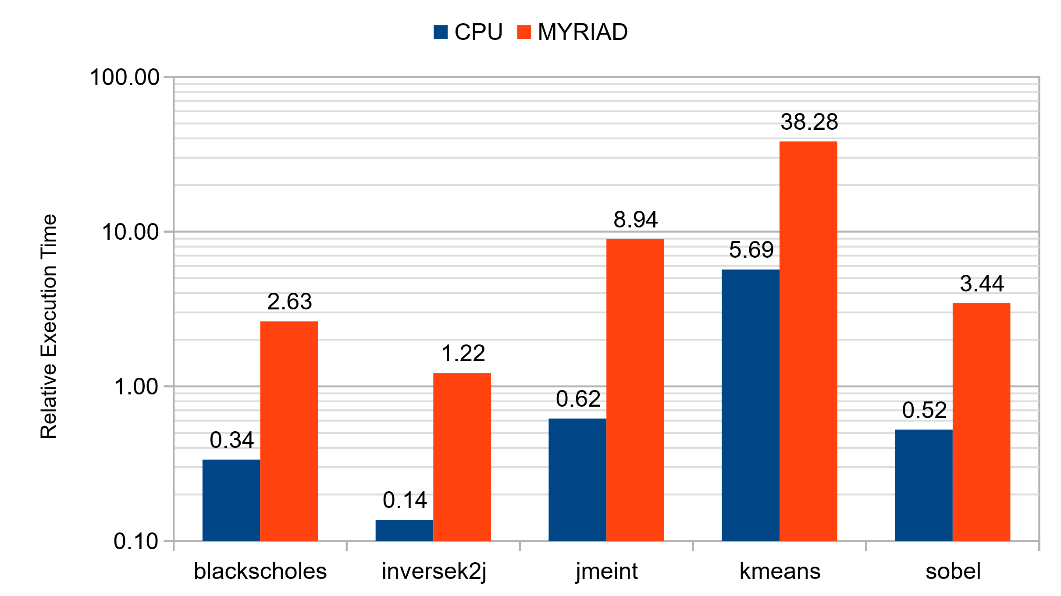
Performance - PC

Slide 25
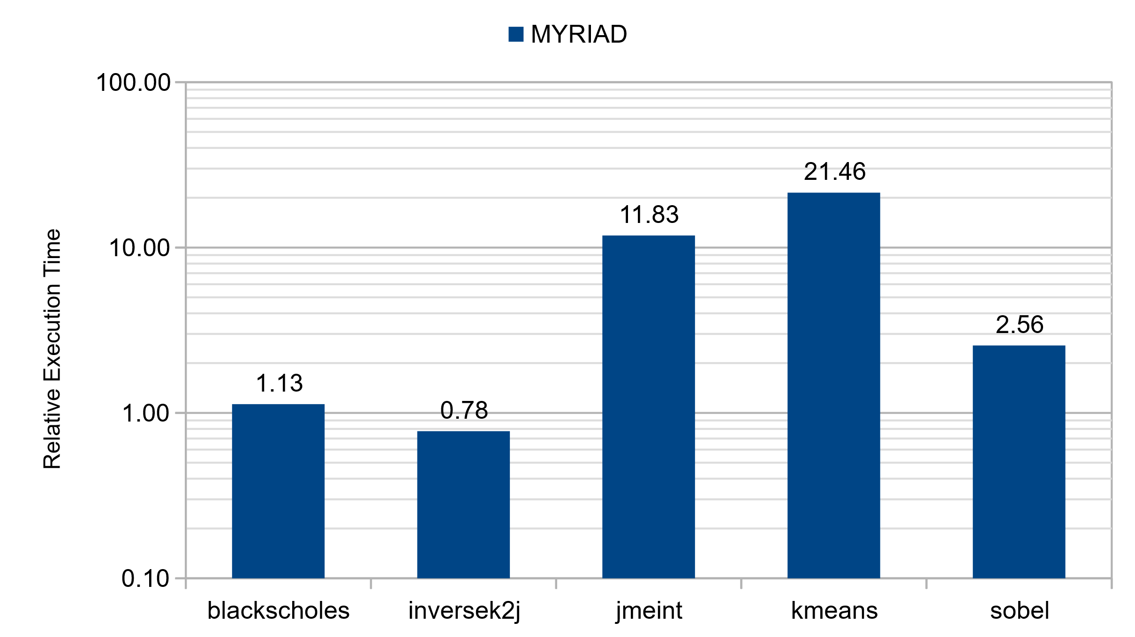
Performance – RPi 3

Slide 26
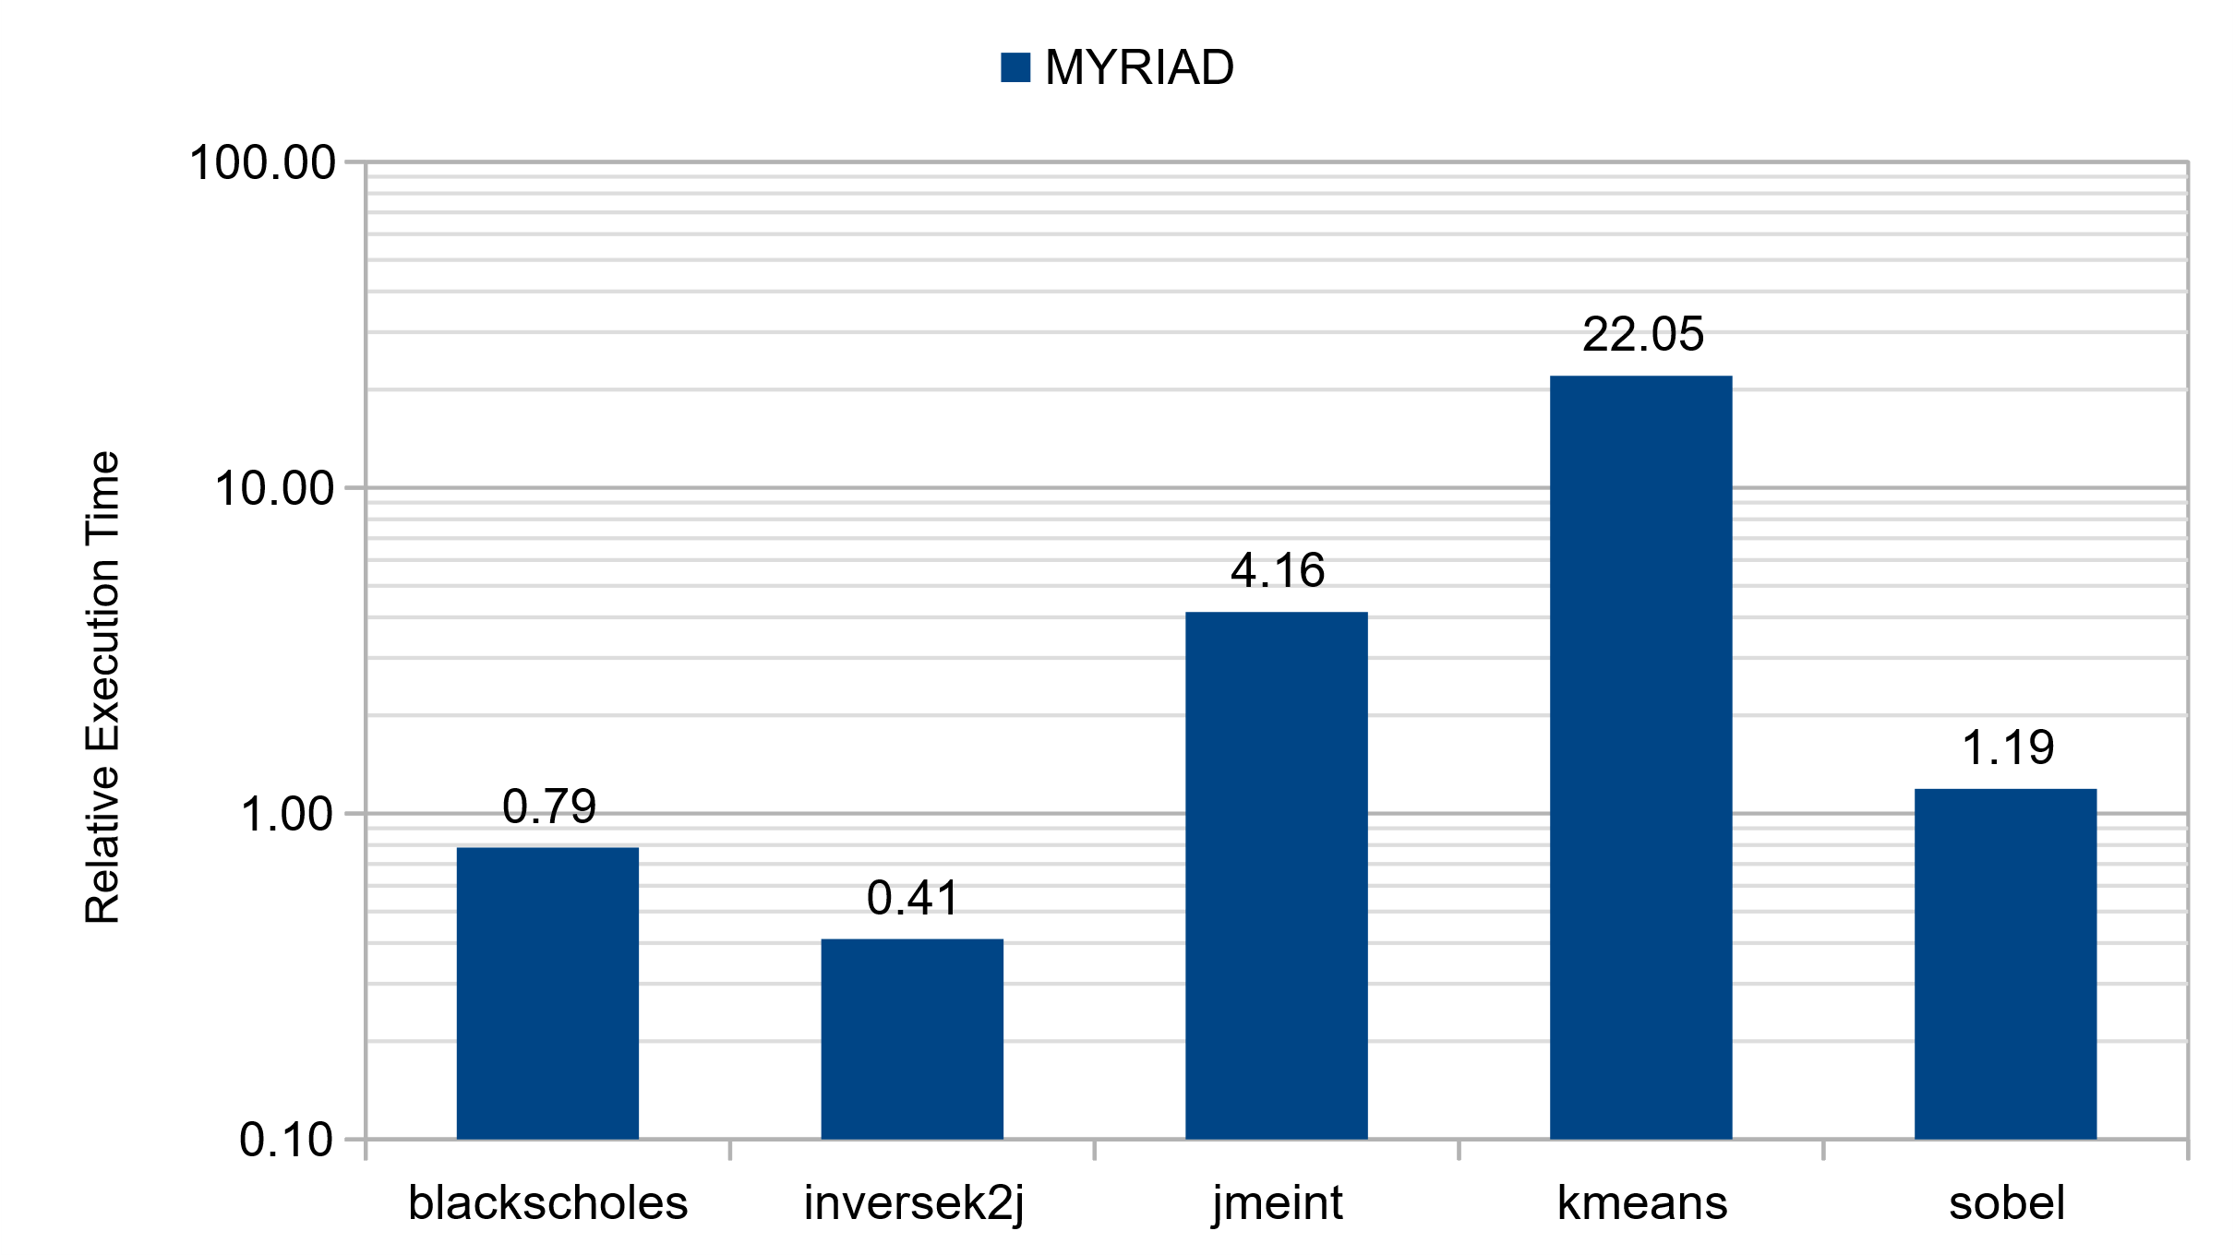
Performance – RPi 4

Slide 27
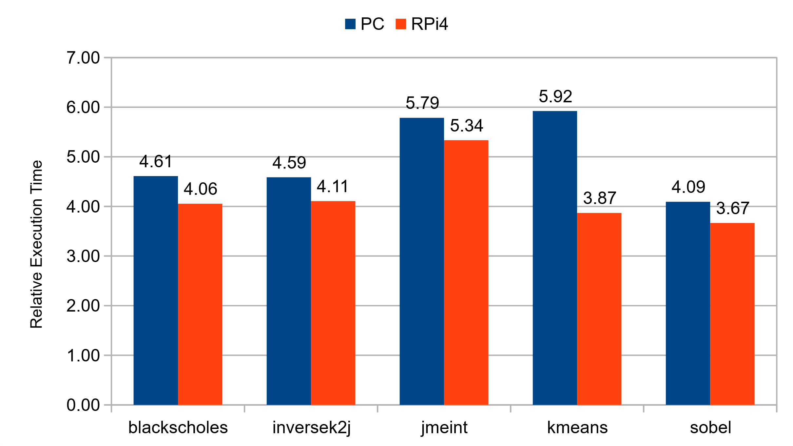
USB2 vs USB3

Slide 28
NN Topologies
 | NN 1 |  | NN 2 |  | NN 3
Application | Topology | Parameters | Topology | Parameters | Topology | Parameters
blackscholes | 6-20-1 | 161 | 6-20-20-1 | 581 | 6-20-20-20-1 | 1001
inversek2j | 2-8-2 | 42 | 2-8-8-2 | 114 | 2-8-8-8-2 | 186
jmeint | 18-32-8-1 | 881 | 18-32-16-8-1 | 1281 | 18-32-16-16-8-1 | 1553
kmeans | 6-8-4-1 | 97 | 6-8-6-4-1 | 143 | 6-8-6-6-4-1 | 185
sobel | 9-8-1 | 89 | 9-8-8-1 | 161 | 9-8-8-8-1 | 233

Slide 29
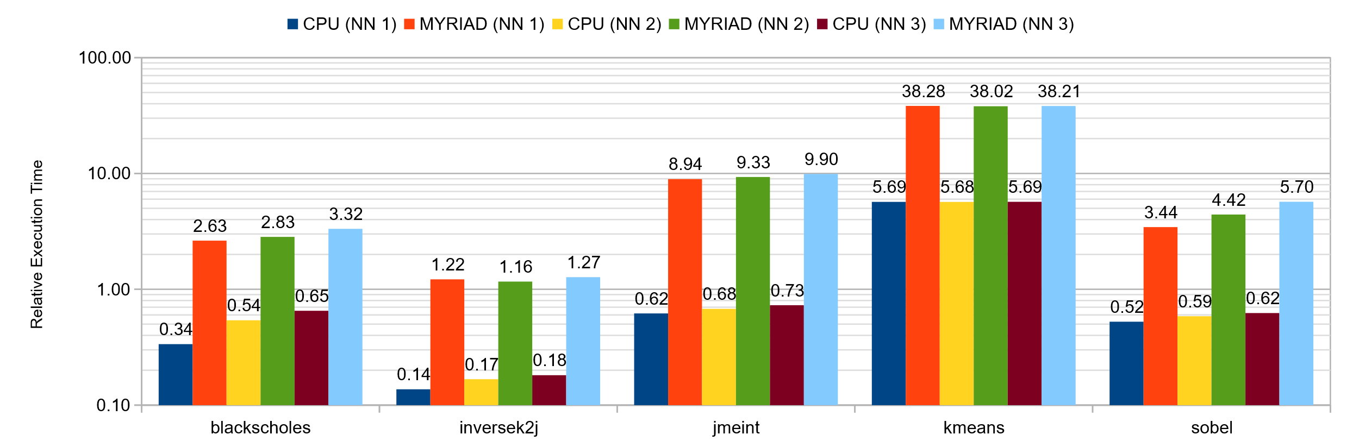
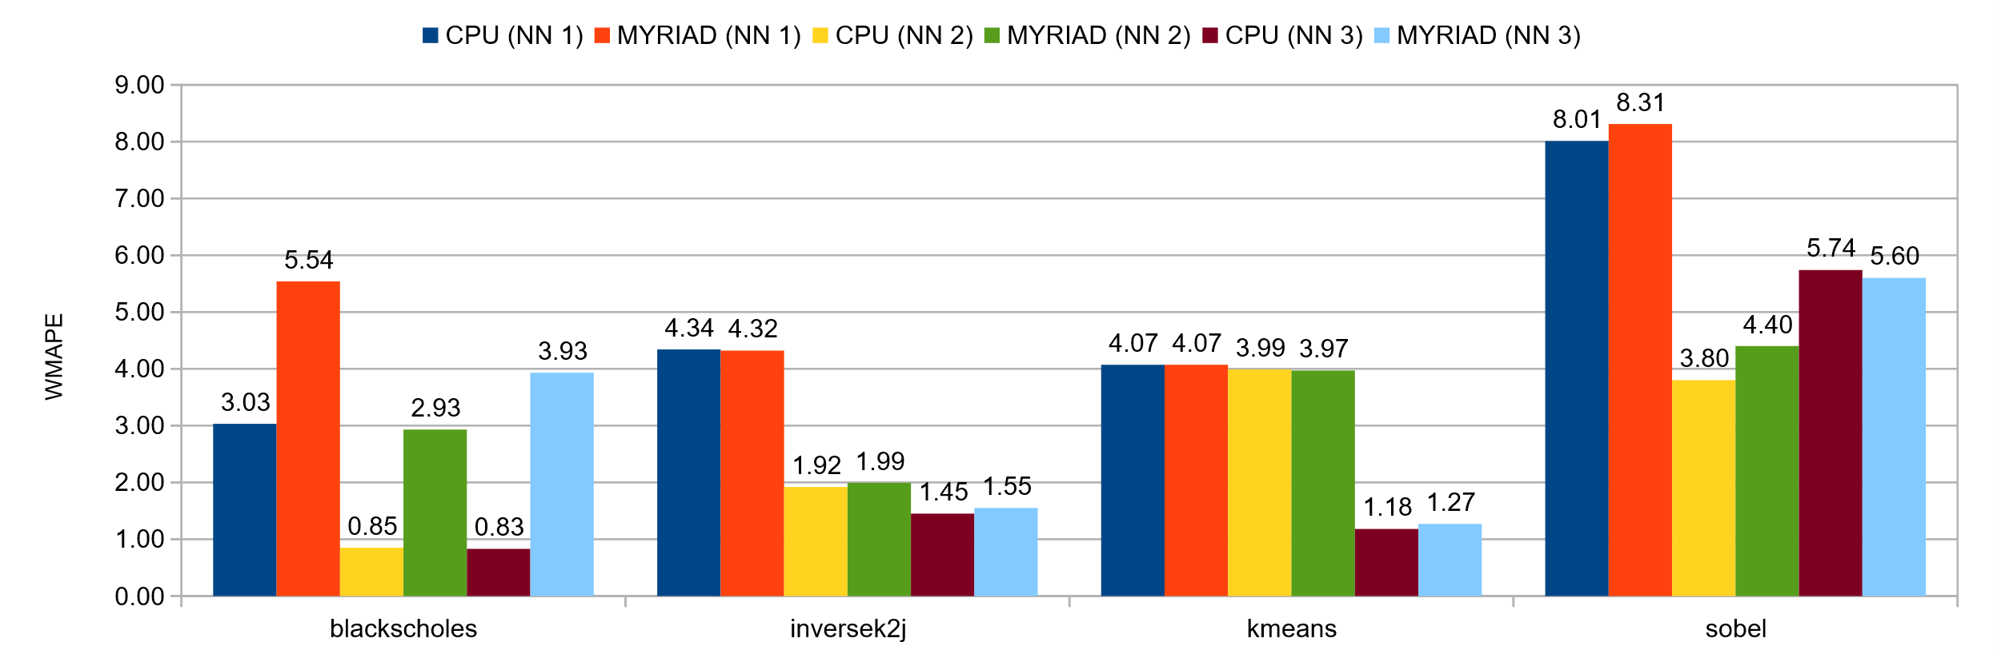
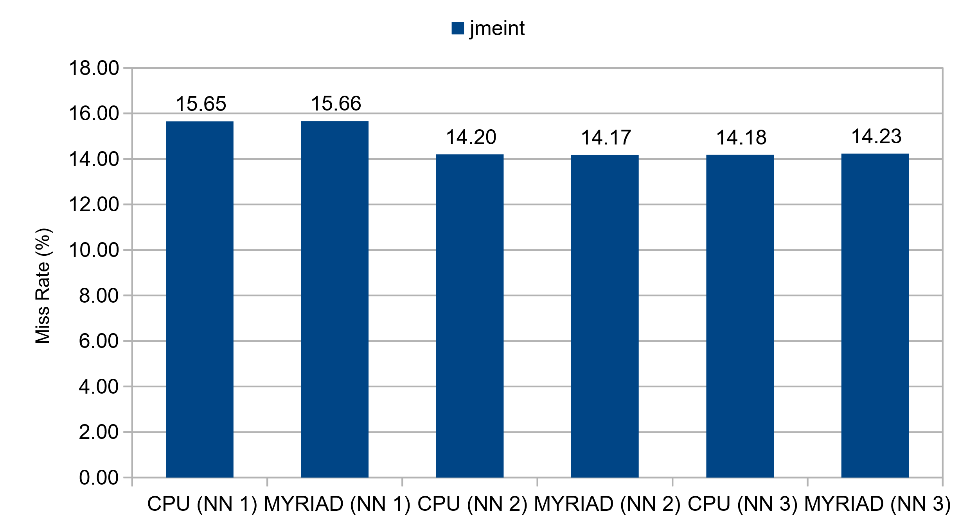
NN Topologies – Comparison

Slide 30
Conclusions

Slide 31
Algorithmic transformation can be done with OpenVINO and the Myriad X VPU.
Manual effort is required to change the code. Not easy to automate.
Traditional DNN need to be converted to CNN to be able process in batches.
Mixed results.
PC: CPU 4/5, Myriad: 0/5
RPi 3: 1/5
RPi 4: 2/5
Loosely coupled accelerator hinders performance.
USB2 is 4.6x slower than USB3.

Slide 32
What’s Next?

Slide 33
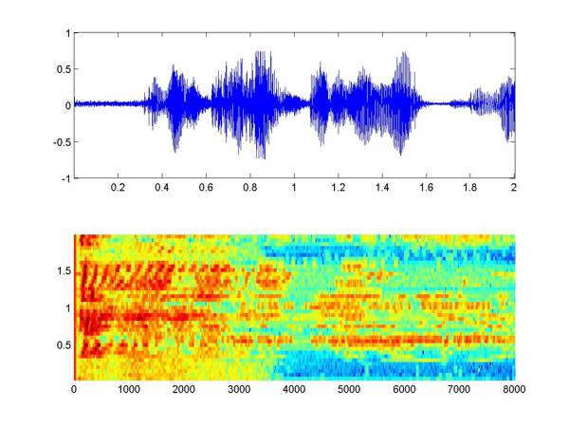
Initial Testing – Audio Classification
Tensorflow
Power consumption
Idle: 2.9 W
Load: 6.1 W
Throughput:
74.32 FPS
Execution time:
13.46 ms / inference
Energy efficiency:
82.11 J / inference
OpenVINO + NCS2
Power consumption
Idle: 3.6 W
Load: 6.6 W
Throughput:
406.33 FPS
Execution time:
2.46 ms / inference
Energy efficiency:
16.24 J / inference
Testing done in RPi 4
https://medium.com/x8-the-ai-community/audio-classification-using-cnn-coding-example-f9cbd272269e

Slide 34
Thanks!

